Slide 1



The role of decentralized generation on Energy Security and consumer empowerment in Mozambique
PRESENTED BY
Laura Nhancale
Advisor to the Board — ARENE
September/2026

Slide 2
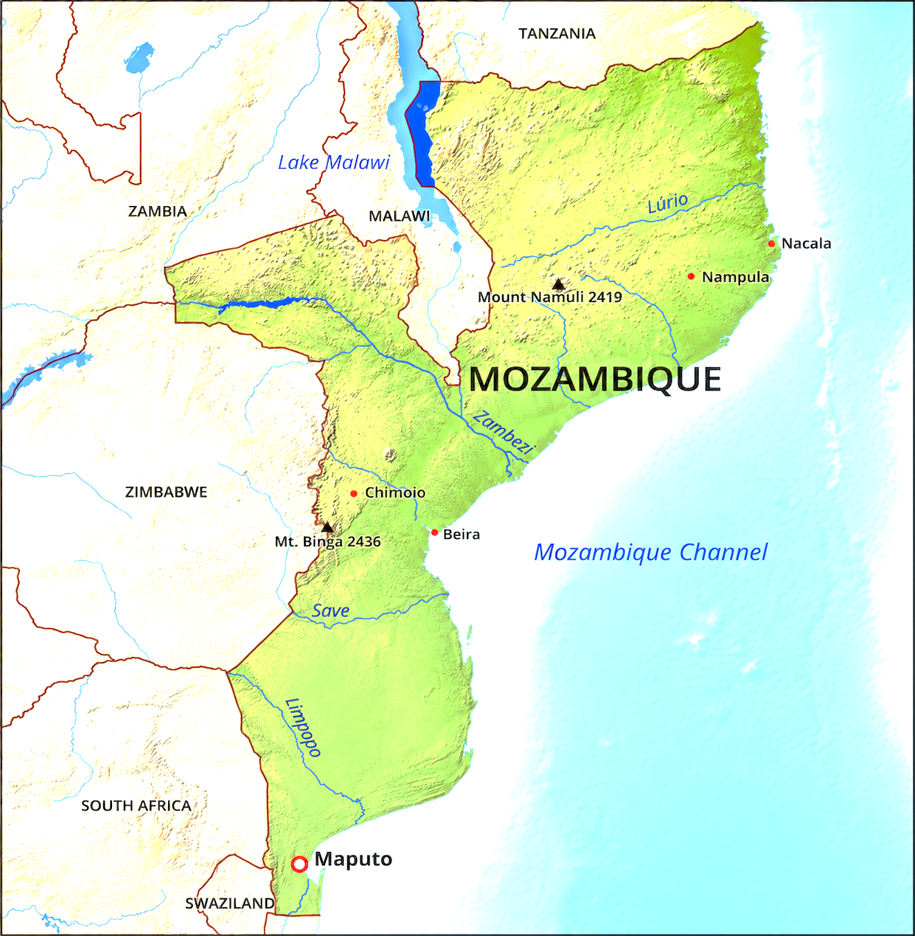

Mozambique at a Glance
Mozambique combines a vast territory, dispersed rural population and significant renewable energy resources, low income economy making, grid extension insufficient to achieve universal access.
801,590 km²
36.64 M
26 USD B
Territorial extension
Population (2026)
Gross Domestic Product
Annual growth ~2.9%
705 USD
4.4 %
1–2 %
GDP per capita
Inflation (2025)
Economic growth
Within central bank target band
Real GDP growth forecast 2026
3
2
2
WFER 2026 · Laura Nhancale · ARENE

Slide 3
Why Decentralized Systems Matter
Three structural drivers make conventional grid extension alone insufficient for universal access.
01
02
03
Dispersed Rural Population
Low Demand & Purchasing Power
Vast Territory, Abundant Renewables
Over 21 million Mozambicans live in rural areas at low density. Many districts fall below 30 inhabitants per km², far below the threshold where grid extension becomes economically viable.
Household consumption is too small to amortize long distribution lines. Limited disposable income constrains the ability to pay cost-reflective tariffs, weakening the investment case for utilities.
With 801,590 km² and an average solar resource of 5.2 kWh/m²/day, Mozambique combines a geography that combine grid extension with a renewable endowment that favors decentralized solar solutions.
Bottom line: Grid extension alone is neither economically efficient nor technically feasible in the short to medium term — Mozambique has adopted a combined on-grid and off-grid strategy to pursue universal access by 2030.
5
3
4
3
2
WFER 2026 · Laura Nhancale · ARENE

Slide 4
Combined Electrification Approach
Mozambique does not choose between centralized and decentralized generation, it coordinates both under a unified strategy.
Households that are unlikely to be reached by the grid , mini grids in the short or medium term as for reaching the last mile
Regional / Local Mini-Grids
Stand-Alone Systems (SHS)
National Grid
grid extension to urban peri-urban but also rural areas
Villages and small towns far from the grid, served by renewable mini-grids.
UNIVERSAL ENERGY ACCESS BY 2030
6
4
5
4
3
2
WFER 2026 · Laura Nhancale · ARENE

Slide 5
Benefits of Decentralization
Five structural advantages that decentralized systems bring to Mozambique's electrification drive.
TIME
EFFICIENCY
CLIMATE
PRODUCTIVITY
INCLUSION
01
02
03
04
05
Faster Deployment
Reduced Losses
Energy Transition
Productive Loads
Local Development
Significantly reduces the time required to deliver electricity services to remote communities where conventional grid extension would take many years.
By generating close to demand, decentralized systems eliminate long-distance transport losses that plague extended grid networks in low-density areas.
Renewable mini-grids reduce diesel dependence, supporting Mozambique's Energy Transition Strategy and climate commitments.
Tailored voltage quality and reliability for rural businesses, schools, clinics and small industries that drive productive use of electricity.
Energy access enables value addition, job creation and SME growth in underserved regions, multiplying the social return on every connection.
7
5
6
5
4
3
2
WFER 2026 · Laura Nhancale · ARENE

Slide 6
Challenges of Decentralization
Six structural challenges must be acknowledged and addressed in the regulatory design.
01
Affordability for Rural Communities
02
High Cost per Customer
03
Low & Uncertain Demand
Low household income limits ability to pay cost-reflective tariffs, requiring subsidy design and cross-subsidy mechanisms.
Capex per connection in remote mini-grids far exceeds urban grid connection, often by a factor of 5–10×.
Rural consumption develops slowly, risking system underutilization and weakening cost recovery assumptions.
04
High Dependence on Subsidies
05
Limited Access to Finance
06
Community & Social Risks
Operations rely on capex and opex support from development partners and government budgets that may not be sustainable long-term.
Local capital markets remain shallow and perceived project risk is high, raising the cost of capital for private operators.
Local expectations, land-use conflicts and population movement can affect project stability and long-term operation.
8
6
7
6
5
4
3
2
WFER 2026 · Laura Nhancale · ARENE

Slide 7
Coordination & Integrated Planning
Three regulatory frameworks operationalize Mozambique's combined on-grid / off-grid strategy.
OFF-GRID
ON-GRID
INTERCONNECTION
Off-grid Planning
On-grid Planning
Interconnection Rules
Resolution No. 52/2023 · 14 December
Resolutions No. 49 & 48/2018 · 3 December
Normative Resolution No. 2/ARENE-CA/2022 · 19 December
Defines three priority areas for mini-grid implementation using a combination of factors: distance from existing or planned distribution network, demographic data (population, density, number of households), existing and planned demand, existing economic and social infrastructure, and existing or planned mini-grids.
National Strategy for Electrification . and Integrated Infrastructure Plan currently under review. Together they define the long-term roadmap for grid extension, generation expansion and interconnection priorities across the country
Establishes the terms, conditions and procedures applicable to the interconnection of mini-grids to the National Grid, ensuring a clear path for off-grid projects to connect to the grid when it arrives the mini grid service area.
Mozambique does not choose between technology option, it coordinates an aligned planning framework.
9
7
8
7
6
5
4
3
2
WFER 2026 · Laura Nhancale · ARENE

Slide 8

Case Study: ARC POWER – MOTSE Mini-Grid
PROJECT FACTS
First private mini-grid in Mozambique
Pioneer project demonstrating private-sector viability
75 kWp solar system
Expandable on demand as connections grow
370 connections
Delivered in 2024 to households and small businesses
Tariff reduced from 0.86 €/kWh ( 64MTs/kWh) to 0.21 €/kWh (16 MTs/kWh)
After SNV/Brilho capex subsidy was included
Maqueze, Chibuto District, Gaza Province
TARIFF COMPARISON (€/kWh)
Private (post-subsidy)
0.21 € · ~16 MTs
Public (national tariff)
0.11 € · ~ 8 MTs
REMAINING CHALLENGES
Population underserved in neighbouring localities (community social risk) · Tariff gap between private and public mini-grids (public mini-grids charge the national grid tariff of ~0.11 €/kWh).
Private (initial)
0.86 € · ~ 64 MTs
9
8
8
7
6
5
4
3
2
WFER 2026 · Laura Nhancale · ARENE

Slide 9
Conclusions: Regulatory Balance
Four priorities for the regulator to consolidate decentralized generation in Mozambique.
01
Predictable Regulatory Framework
02
Technical Capacity
Provided the capital intensive nature and long period maturity of investments for energy infrastructures, predictable and stable regulations are required.
Maintaining decentralized systems requires skilled local technicians, reliable supply chains for spare parts, and sustainable operation and maintenance arrangements that can survive the project lifecycle.
03
Demand Risk Mitigation
04
Institutional Coordination
Electricity demand often develops more slowly than initially projected. Without complementary investments in productive uses of electricity, many systems remain underutilized and financially unsustainable.
Successful implementation requires effective collaboration among government institutions, the regulator, the utility, rural electrification agencies, local authorities, development partners and private investors.
12
9
9
8
7
6
5
4
3
2
WFER 2026 · Laura Nhancale · ARENE

Slide 10
Conclusions
Decentralized generation plays a critical role in strengthening energy security and empowering consumers in Mozambique, particularly in rural and remote communities where grid extension is not economically viable.
To realize its full potential, decentralized generation requires a predictable regulatory framework, adequate financing instruments, technical capacity building and effective institutional coordination across all stakeholders.
The combined on-grid and off-grid strategy is aligned with the goal of universal electricity access by 2030 and with the Energy Transition Strategy of Mozambique.
12
10
9
8
7
6
5
4
3
2
WFER 2026 · Laura Nhancale · ARENE

Slide 11
Thank You!
Laura Nhancale
Advisor to the Board – ARENE

